Slide 1



Planning and teaching oral language in Warlpiri school programs
Carmel O’Shannessy, University of Michigan
Samantha Disbray, Charles Darwin University & Australian National University
Multilingual Repertoires and Multilingual Discourse Workshop
Western Sydney University, Oct 26-28, 2016

Slide 2
About the project
Collaboration between Warlpiri educators in 4 Central Australian Schools, Carmel O’Shannessy and Samantha Disbray.
2010 – 2012 Carmel documented Warlpiri children’s language and created audio-visual reports.
2012 & 2016 Samantha developed and delivered professional learning sessions for educators in the four Warlpiri schools on oral language teaching and monitoring.
2016 educators at Yuendumu school commenced a project to systematically teach and monitor oral Warlpiri in its bilingual program.

Slide 3
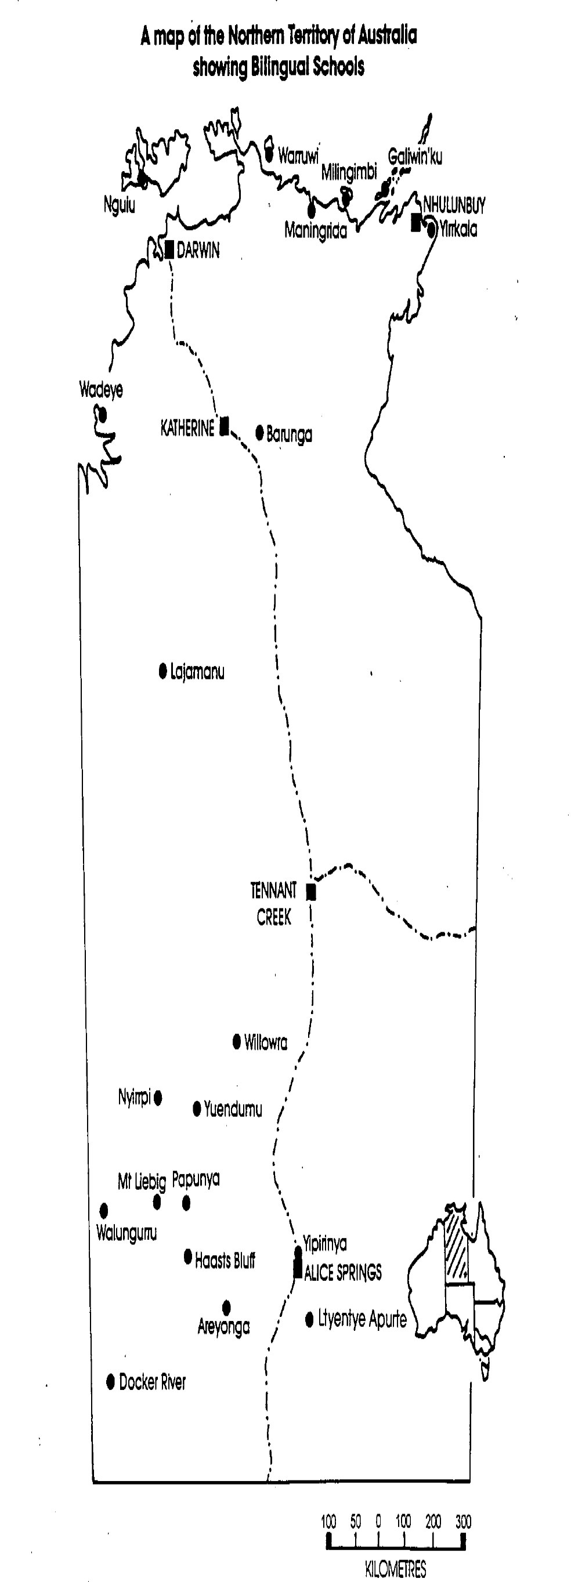
Bilingual education in the Warlpiri schools
(cf. Baarda & Ross, in press; Devlin, Disbray, & Devlin, in press; Disbray, 2014a, 2014b; Disbray & Martin, forthcoming; Hoogenraad, 2001)

Slide 4
Making a place for L1 oral language in school programs
The focus in schools on L1 language is on literacy outcomes rather than oracy and language competency
(Guenther, Disbray & Osborne, 2016; McIntosh, O’Hanlon, & Angelo, 2012).
Literacy teaching focus on low level, grapho-phonics skills.
Little context for literacy in everyday language practice in Warlpiri communities and there is little or no reinforcement in home literacy practices.

Slide 5
Making a place for L1 oral language in school programs
Revitalisation programs target language learning
(Hobson, Lowe, Poetsch, & Walsh, 2010; Reyhner & Lockard, 2009)
In language maintenance settings, without attention to oral language, language development may suffer
(cf. Allen, 2007; Campbell & Muntzel, 1989; O'Shannessy, 2012).

Slide 6
Making a place for L1 oral language in school programs
Is L1 oral language competence and performance assumed?
Teaching oral language in an L1 context might be intimidating
preparation is time-consuming
models of best practice for L1 context are scarce.

Slide 7
Process: Step 1: data collection
Carmel O’Shannessy recorded children aged 6-10 years telling stories based on picture stimuli
Stimuli were designed to
elicit overt transitive subjects
collect data on use of word order and ergative case marking
3 stories used in this part of the project
Carmel transcribed the recordings, with help from Warlpiri speakers as needed
(O’Shannessy 2008, 2009, 2011, 2012, 2013)

Slide 8
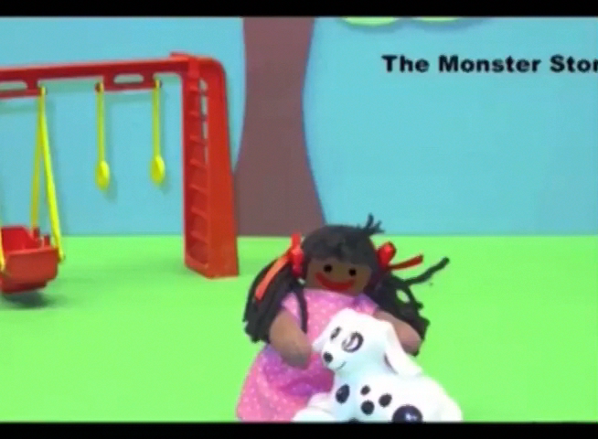

Slide 9
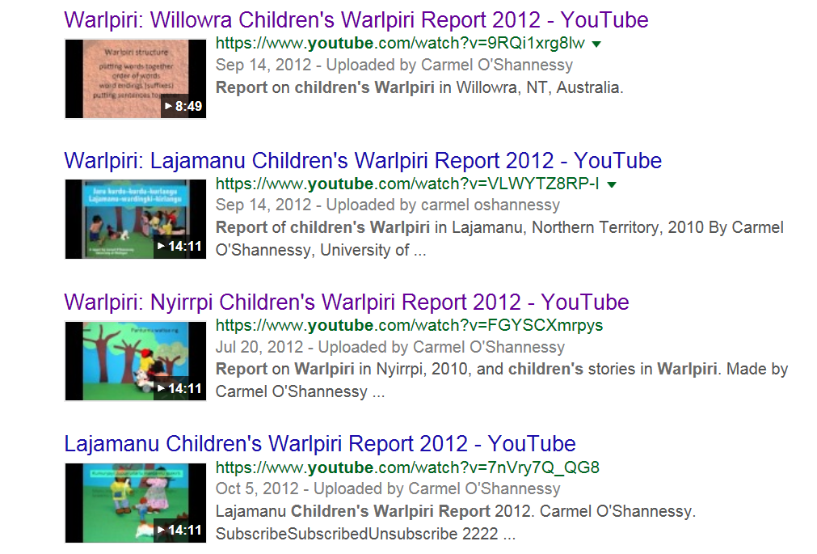
Process: Step 2: Interpret data
Researcher agreed to write a report on children’s language for NT DET, in return for recording children in school time
But ... who would read a written report? no-one!
so ... audiovisual report for the Warlpiri teachers – aimed at teachers with no linguistics training
https://www.youtube.com/watch?v=9RQi1xrg8lw

Slide 10
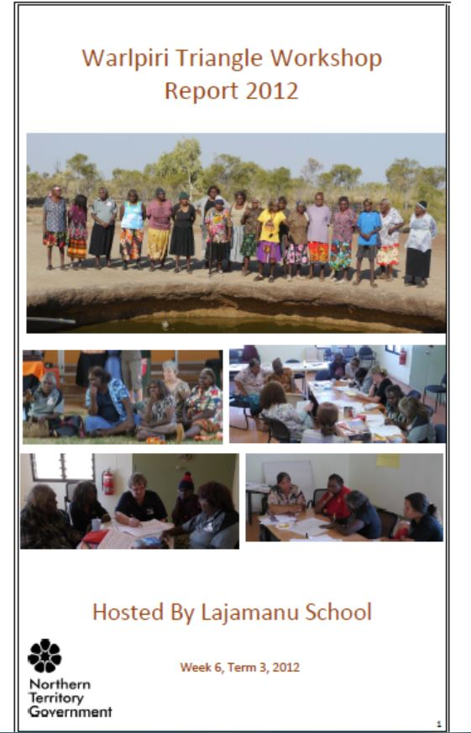
Process: Step 3: Teacher professional development
Context
Annual Warlpiri Triangle Workshop - Teachers and elders from 4 Warlpiri communities come together – Yuendumu, Lajamanu, Willowra, Nyirrpi
to develop curriculum
pedagogical practices
discuss teaching strategies
create resources
share strengths of programs in each community.
Teachers have awareness that the children might speak differently in each place.

Slide 11
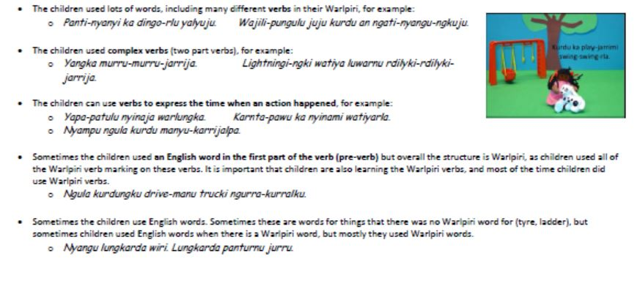
Process: Step 3a: Prepare for teacher analysis of children’s oral texts
Teachers watched the videos and in a group brainstorm re-capped some of the points
They listen to individual stories and read written transcripts
Extract from NT Department of Education (2012) Warlpiri Triangle Report 2012 p.38

Slide 12
Process: Step 3b: Teacher analysis of children’s oral texts
Viewing transcripts of children’s narrations in their school groups, teachers carried out language analysis and observed:
Some children use different styles within a story for discourse purposes
change pitch, lengthen vowel, e.g yanu-u-u-u
indicate suspense, direct speech.
Some children told detailed and often exciting stories, others very short and abridged stories, with a narrow vocabulary and limited plot development.
Use of English borrowings, in particular sentence sequencing devices.
Use in some cases of rich Warlpiri vocabulary, such as verbs.
Pronunciation features, such as elision of consonant clusters in some morphemes (jangka -> janga; yanilpa -> yanipa; nyinpa -> nyinilpa and omission of final vowels.

Slide 13
What do chn know? | What do they need to learn? | How will we make sure they learn this?
All schools All the sounds in Warlpiri Lots of words – verbs and ways to express different times in Warlpiri (Grammar) , nouns and lots of endings – actor, dative location (Grammar) Lots of endings in the right places – like ngka - but some will change if children only use the quick way to say –ngk and -nga | Make sure they say the endings in a strong way (adults do say ngk and leave off other end vowels too, but children might not learn that those sounds are there, just a bit short when people speak fast) -nga -> ngka | Seeing the words and endings in writing, because the lasts sounds are written and when you read them you see them and say them too. Develop good, gentle, helpful ways to correct speech – like repeat back in the proper way
Lajamanu How to tell a story & words to use Endings –ngka, rra, ngu, nga Hard Warlpiri words – nouns, verbs and endings (grammar) How to speak Light Warlpiri | The differences between light Warlpiri and Warlpiri Word order in Warlpiri More Warlpiri verbs, more Warlpiri nouns Words to start sentences: ngulajanka, nyampu, yuwayi, yangka (not ‘well) | Teaching verbs/songs/ Simon says…/play games with hand signs & flashcards for chn to do actions Read long stories that have these words that join up sentences Writing stories in Warlpiri
Willowra Strong verbs/good vocabulary Lots of hard structures and grammar -jarrija | More vocabulary, so that kids use new Warlpiri words for English things – eg: flat tyre jarrija= rdilyki jarrija | Teach Warlpiri words in the learning areas eg/ actions -science

Slide 14
Process: Step 4: Teachers identify teaching & learning strategies
Feedback to students – recast students’ productions.
Teachers plan to pay attention to own speech – e.g. don’t contract endings.
Teach contemporary songs and think of them as oral texts, rather than as just as songs.
Find texts with advanced Warlpiri vocabulary, and highlight specific elements in class reading, viewing and discussion.
Plan for increased Warlpiri vocabulary use, through word banking.
Teach more types of sentence beginnings.
Integrate specifics of oral language use with regular theme curriculum planning.
Plan student presentations for assembly as assessment for theme work.
Senior students make movies with subtitles, and listen carefully.

Slide 15
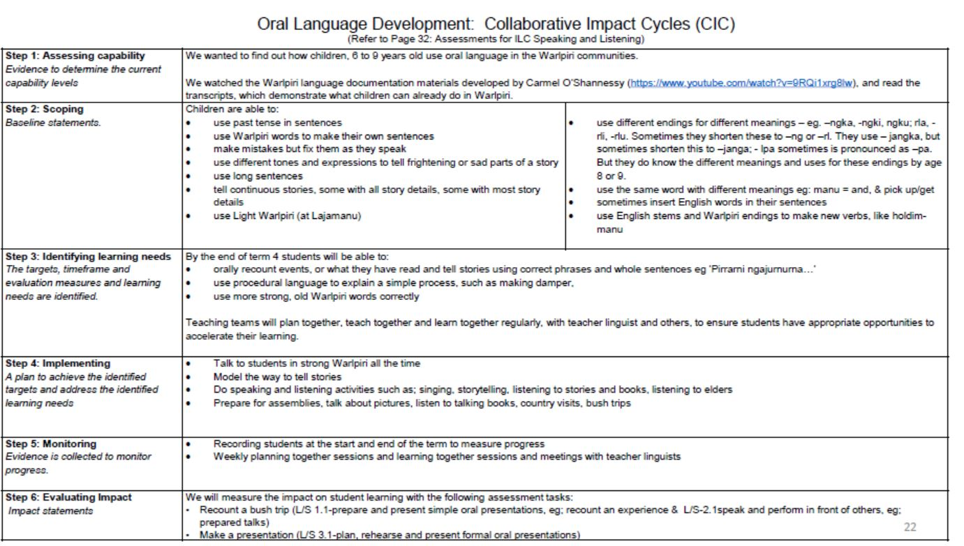
Process: Step 5 Planning, teaching and monitoring oral language
Northern Territory Department of Education (2016) Warlpiri Triangle Report 2016

Slide 16
Contextualising the practice: Understanding children’s language repertoires
Research materials provide evidence for statements about the language situation in a community.
Language ecologies in Indigenous communities are complex & the complexity of children’s language knowledge is not immediately apparent from superficial observation
(for instance, without recordings of children speaking strong Warlpiri in Lajamanu, it would not be know that they can do speak strong Warlpiri).
With recorded and transcribed material, teachers can focus on what children actually say.

Slide 17
Contextualising the practice: Celebrating the children’s oral language competence
How often do we stop and celebrate that the children are really good at L1 oral language production?
The focus on oral skill reinforces that it is valued.
Children were recorded in school time.
They were given copies of their stories on USB by the researcher.
The process acknowledges and celebrates children’s L1 competence and use.
The process reinforces the value of Warlpiri and Warlpiri oral language development, by monitoring it as we do (or should do) children’s performance in English.

Slide 18
Contextualising the practice: Professional learning for teachers about language structure
Equips teachers with understandings and language to talk about L1 language structures.
Contributes to the collective learning of the network of education professionals (Disbray 2014a, 2014b, Disbray, in press, Disbray and Martin, forthcoming).

Slide 19
Contextualising the practice: Research – pedagogy collaboration
Language documentation originally for research purposes feeds directly into local pedagogy and school learning.
Collaboration of documentation and in-school-time professional development makes it possible.

Slide 20
Contextualising the Practice: Enhanced L 1, bi-/multi-lingual literacy development
Increased oral L1 practice is vital for all other aspects of languages development
L1 literacy, L2 oracy and literacy, subsequent languages.
Lexical development, vocabulary size and depth have a significant effect on reading and on writing in first language
(August, Carlo, Dressler and Snow, 2005; Verhoeven & Perfetti, 2011; Verhoeven, Van Leeuwe and Vermeer 2011).
L1 vocabulary and L2 vocabulary can contribute to reading comprehension in L2
(Proctor, Carlo, August, & Snow, 2006; Carlisle, Beeman, Davis & Spharim, 1999; Droop and Verhoeven 2003; Hammer, Lawrence, and Miccio, 2007), with evidence of language competition.
‘Central processing' framework proposes that language operations such as word recognition strategies, intra-textual perceptions, meta-cognitive strategies, prior knowledge and schema formation are transferable across languages
(Bernhardt & Kamil, 1995; Bialystok, Luk, & Kwan, 2005; Durgunoglu, 2002; Geva & Siegel, 2000; McBride-Chang, Cheung, Chow, Choi, & Choi, 2006 Quiroz, Snow & Zhao (2010, pp. 381- 382).

Slide 21
Contextualising the practice: Transfer process to other contexts
If a language doesn’t have equivalent resources, language analysis possible with only 3 – 5 recordings.
Transcription allows attention to what children are doing with language.
L1 speaker can enlist help from another teacher or a linguist to transcribe if necessary.
Transcription doesn’t need to be in fancy software.

Slide 22
Contexts where there is less traditional language use
Recordings children might show use of some elements of traditional language in children’s contemporary language, e.g. Wumpurrarni English.
Local variety is a coolamon or vessel for the traditional language
(Morrison & Disbray, 2008).
Further development of a similar collaboration with Warumungu educators in Tennant Creek drawing on the Aboriginal Child Language Acquisition project (ACLA), through the Warumungu project commenced under Centre of Excellence, Dynamics of Languages.

Slide 23
Contextualising the practice: Fostering multilingualism
Professional learning process helps schools to strengthen bilingual or multilingual practices – it overcomes the danger of most school resources being about English.
we all hear other languages, Anmatyerre, Pintupi, Luritja, Pitjantjatjara, whatever languages are spoken in NT, in other communities, out in the desert. For desert people can understand each other. […] We want to have our own language and our own culture in schools, then young ones can understand and learn lots of languages: Luritja or English, Anmatyerre, Arrernte. They can understand one another and all the languages can be stronger. [...]
All these language and culture skills come in together. English is a second language for everybody. I see that with my eyes and hear it with my ears. When Aboriginal people are together, and playing AFL (Australian football), they understand each other. Each of those people from different communities, they can understand. Yes, when people come together, children too, for sports weekends, like church or sorry (mourning and mortuary rites), they are learning, learning other languages
(Baarda & Ross in Devlin, Disbray & Devlin, in press)

Slide 24
Acknowledgements
Thank you to:
Warlpiri-patu-kurlangu Jaru ‘Warlpiri Triangle’ schools, including community members, teachers, children
Northern Territory Department of Education
Warlpiri Education and Training Trust
Northern Institute, Charles Darwin University
School of Languages, Australian National University
University of Michigan Linguistics Department, Office of the Vice-Provost for Research, College of Literature, Science and the Arts, USA National Science Foundation Award 1348013
Centre of Excellence, Dynamics of Languages

Slide 25
Selected References
Carlisle, J. F., Beeman, M. M., Davis, L. H., & Spharim, G. (1999). Relationship of metalinguistic capabilities and reading achievement for children who are becomming bilingual. Applied Psycholinguistics, 20, 459-478.
Droop, M., & Verhoeven, L. (2003). Language proficiency and reading ability in first- and second-language learners. Reading Research Quarterly, 38 (1), 78-103.
Baarda, W., & Ross, T. (in press). Starting out at Yuendumu school — teaching in our own language. In B. Devlin, S. Disbray, & N. Devlin (Eds.), History of bilingual education in the Northern Territory: People, programs and policies. Singapore: Springer Publishing.
Devlin, B., Disbray, S., & Devlin, N. (Eds.). (in press). History of bilingual education in the Northern Territory: People, programs and policies. Singapore: Springer Publishing.
Disbray, S. (2014a). At benchmark? Evaluating the Northern Territory Bilingual Education Program In L. Gawne & J. Vaughan (Eds.), Selected Papers from the 44th Conference of the Australian Linguistics Society, 2013. Melbourne University of Melbourne http://hdl.handle.net/11343/40960.
Disbray, S. (2014b). Evaluating Bilingual Education in Warlpiri Schools. In R. Pensalfini, M. Turpin, & D. Guillemin (Eds.), Language Description informed by Theory (pp. 25-46). Amsterdam, Netherlands: John Benjamins.
Disbray, S., & Martin, B. (forthcoming). Curriculum as Knowledge System: The Warlpiri Theme Cycle. In G. Wigglesworth, J. Simpson, & J. Vaughan (Eds.), From Home to School: Language Practices of Indigenous and Minority Children. Melbourne, Australia: Palgrave Macmillan.
Guenther, J., Disbray, S., Osborne, S., & Batt, M. (2016). Language teaching and learning. In Red Dirt Education. A compilation of learnings from the Remote Education Systems project. Alice Springs: Ninti One, CRC-REPNinti One, CRC-REP http://www.crc-rep.com.au/resource/RedDirtEducation_CompilationLearningsRES_EBook.pdf.
Hobson, J., Lowe, K., Poetsch, S., & Walsh, M. (Eds.). (2010). Re-awakening languages: theory and practice in the revitalisation of Australia’s Indigenous languages. Sydney: Sydney University Press.
Hoogenraad, R. (2001). Critical reflections on the history of bilingual education in Central Australia. In J. Simpson, D. Nash, M. Laughren, P. Austin, & B. Alpher (Eds.), Forty years on: Ken Hale and Australian languages (pp. 123-150). Canberra: Pacific Linguistics.

Slide 26
Selected References
Morrison, B., & Disbray, S. (2008). Warumungu children and language in Tennant Creek. In R. Amery & J. Nash (Eds.), Warra wiltaniappendi = Strengthening languages. Proceedings of the Inaugural Indigenous Languages Conference (ILC) 2007 (pp. 107-111). Adelaide, Australia.
O'Shannessy, C. (2008). Children's production of their heritage language and a new mixed language. In J. Simpson & G. Wigglesworth (Eds.), Children's Language and Multilingualism (pp. 261-282). London: Continuum.
O'Shannessy, C. (2009). Language variation and change in a north Australian indigenous community. In J. Stanford & D. Preston (Eds.), Variation in Indigenous Minority Languages (pp. 419-439 ). Amsterdam/Philadephia: John Benjamins.
O'Shannessy, C. (2011a). Competition between word order and case-marking in interpretng grammatical relations: a case study in multilingual acquisition. Journal of Child Language, 38, 763-792
O'Shannessy, C. (2011b). Young children's social meaning-making in a new mixed language. In U. Eickelkamp (Ed.), Growing Up in Central Australia - Indigenous Experiences of Childhood, Youth and Transformations (pp. 131-155 ). New York: Berghahn Book.
O'Shannessy, C. (2013). The role of multiple sources in the formation of an innovative auxiliary category in Light Warlpiri, a new Australian mixed language. Language, 89(2), 328-353.
O'Shannessy, C. (2015). Multilingual children show language differentiation through indexing communities of practice. First Language, 35, 305-326.
O'Shannessy, C., & Meakins, F. (2012). Comprehension of competing argument marking systems in two Australian mixed languages. Bilingualism: Language and Cognition, 15(2), 378-396.
Quiroz, B. G., Snow, C. E., & Zhao, J. (2010). Vocabulary skills of Spanish-English bilinguals: impact of mother-child language interactions and home language and literacy support. International Journal of Bilingualism, 14, 379+.
Reyhner, J., & Lockard, L. (Eds.). (2009). Indigenous Language Revitalization: Encouragement, Guidance & Lessons Learned. Flagstaff, AZ: Northern Arizona University.

